Slide 1

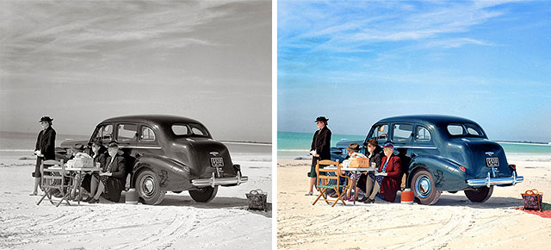
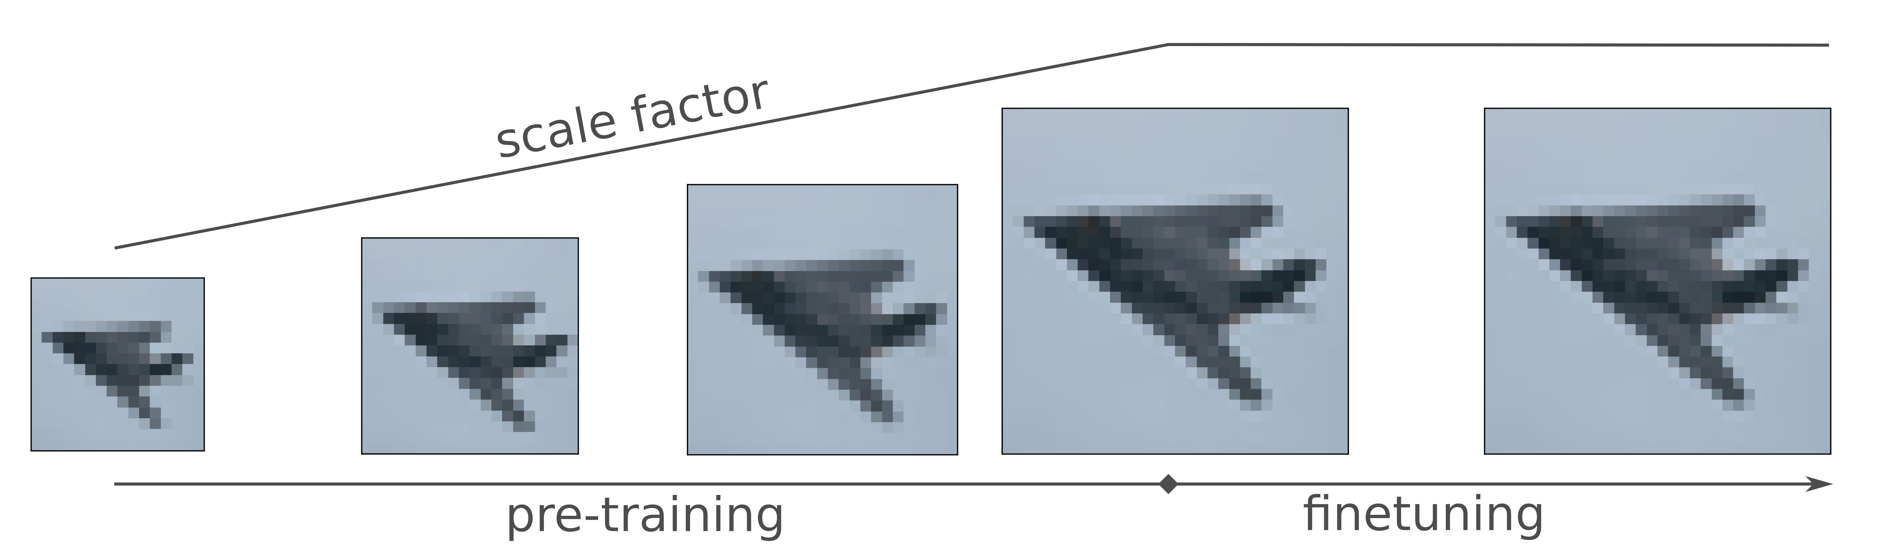
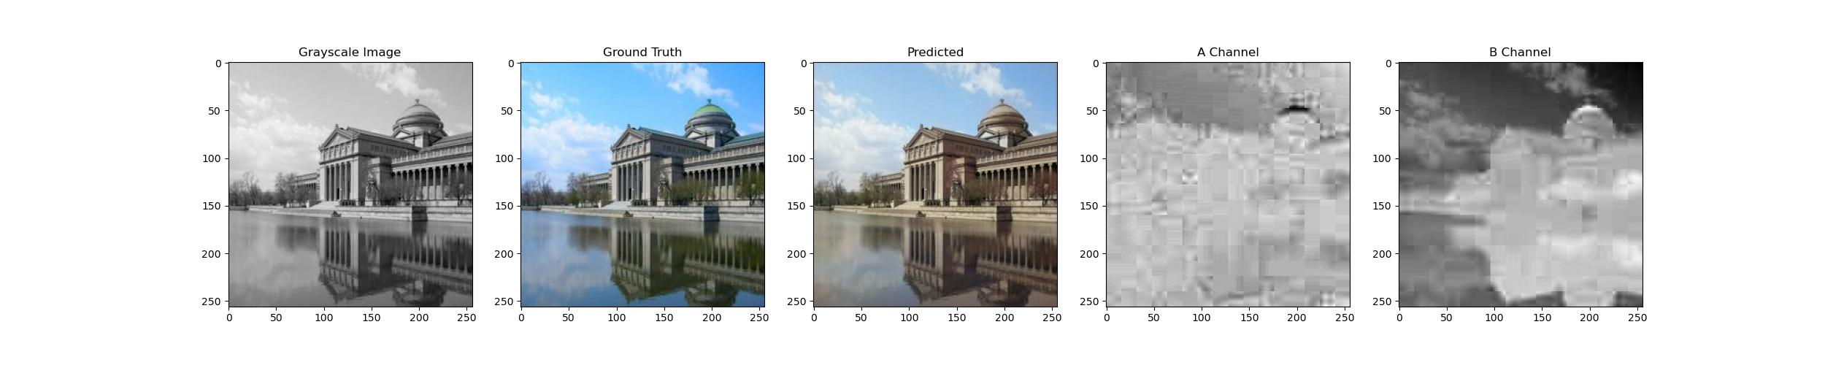
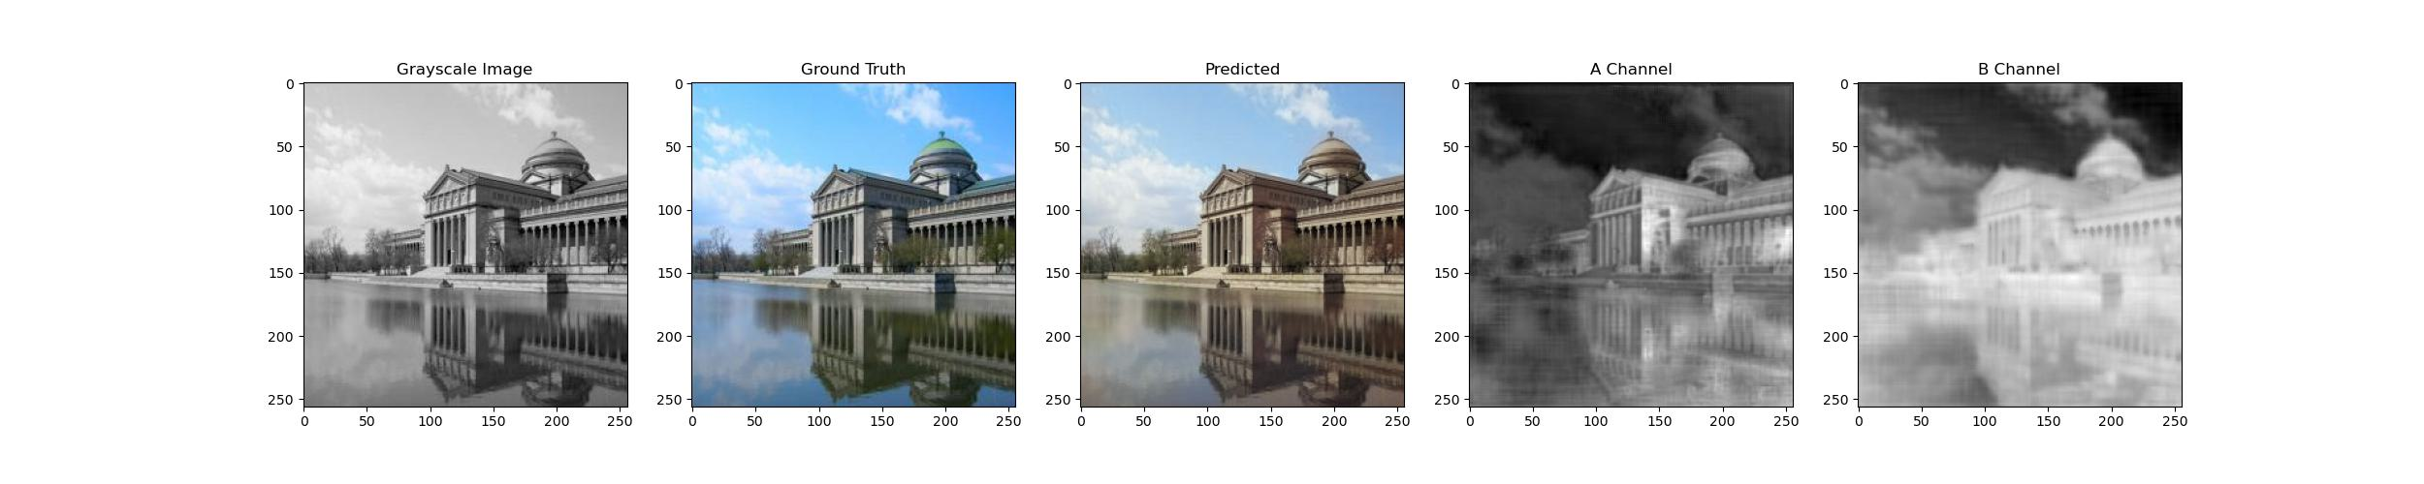
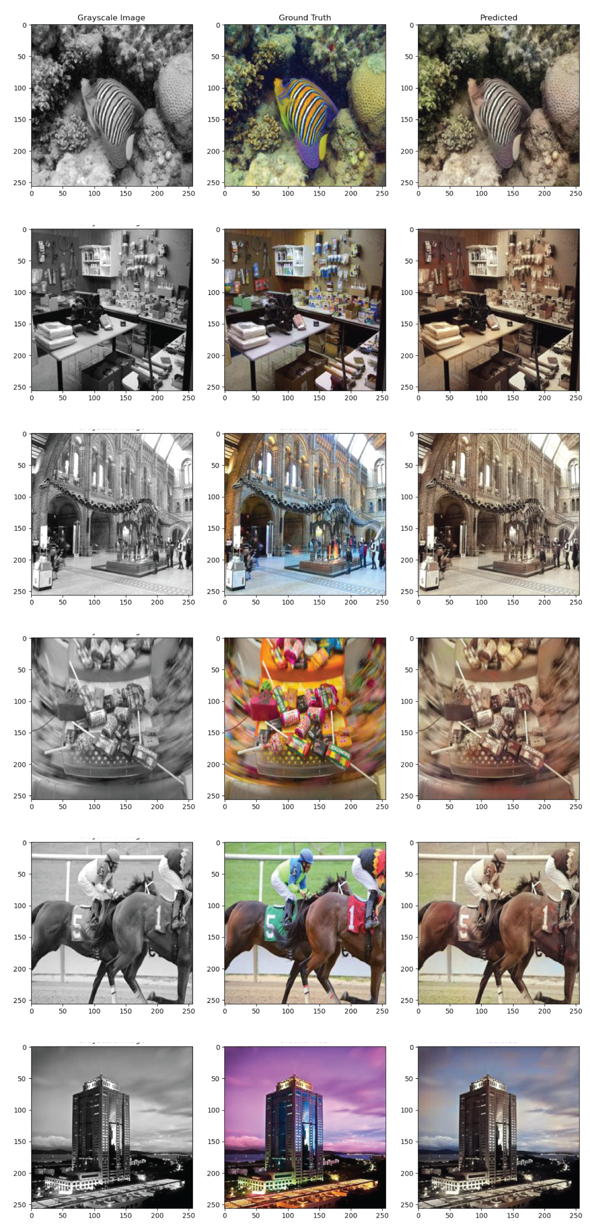
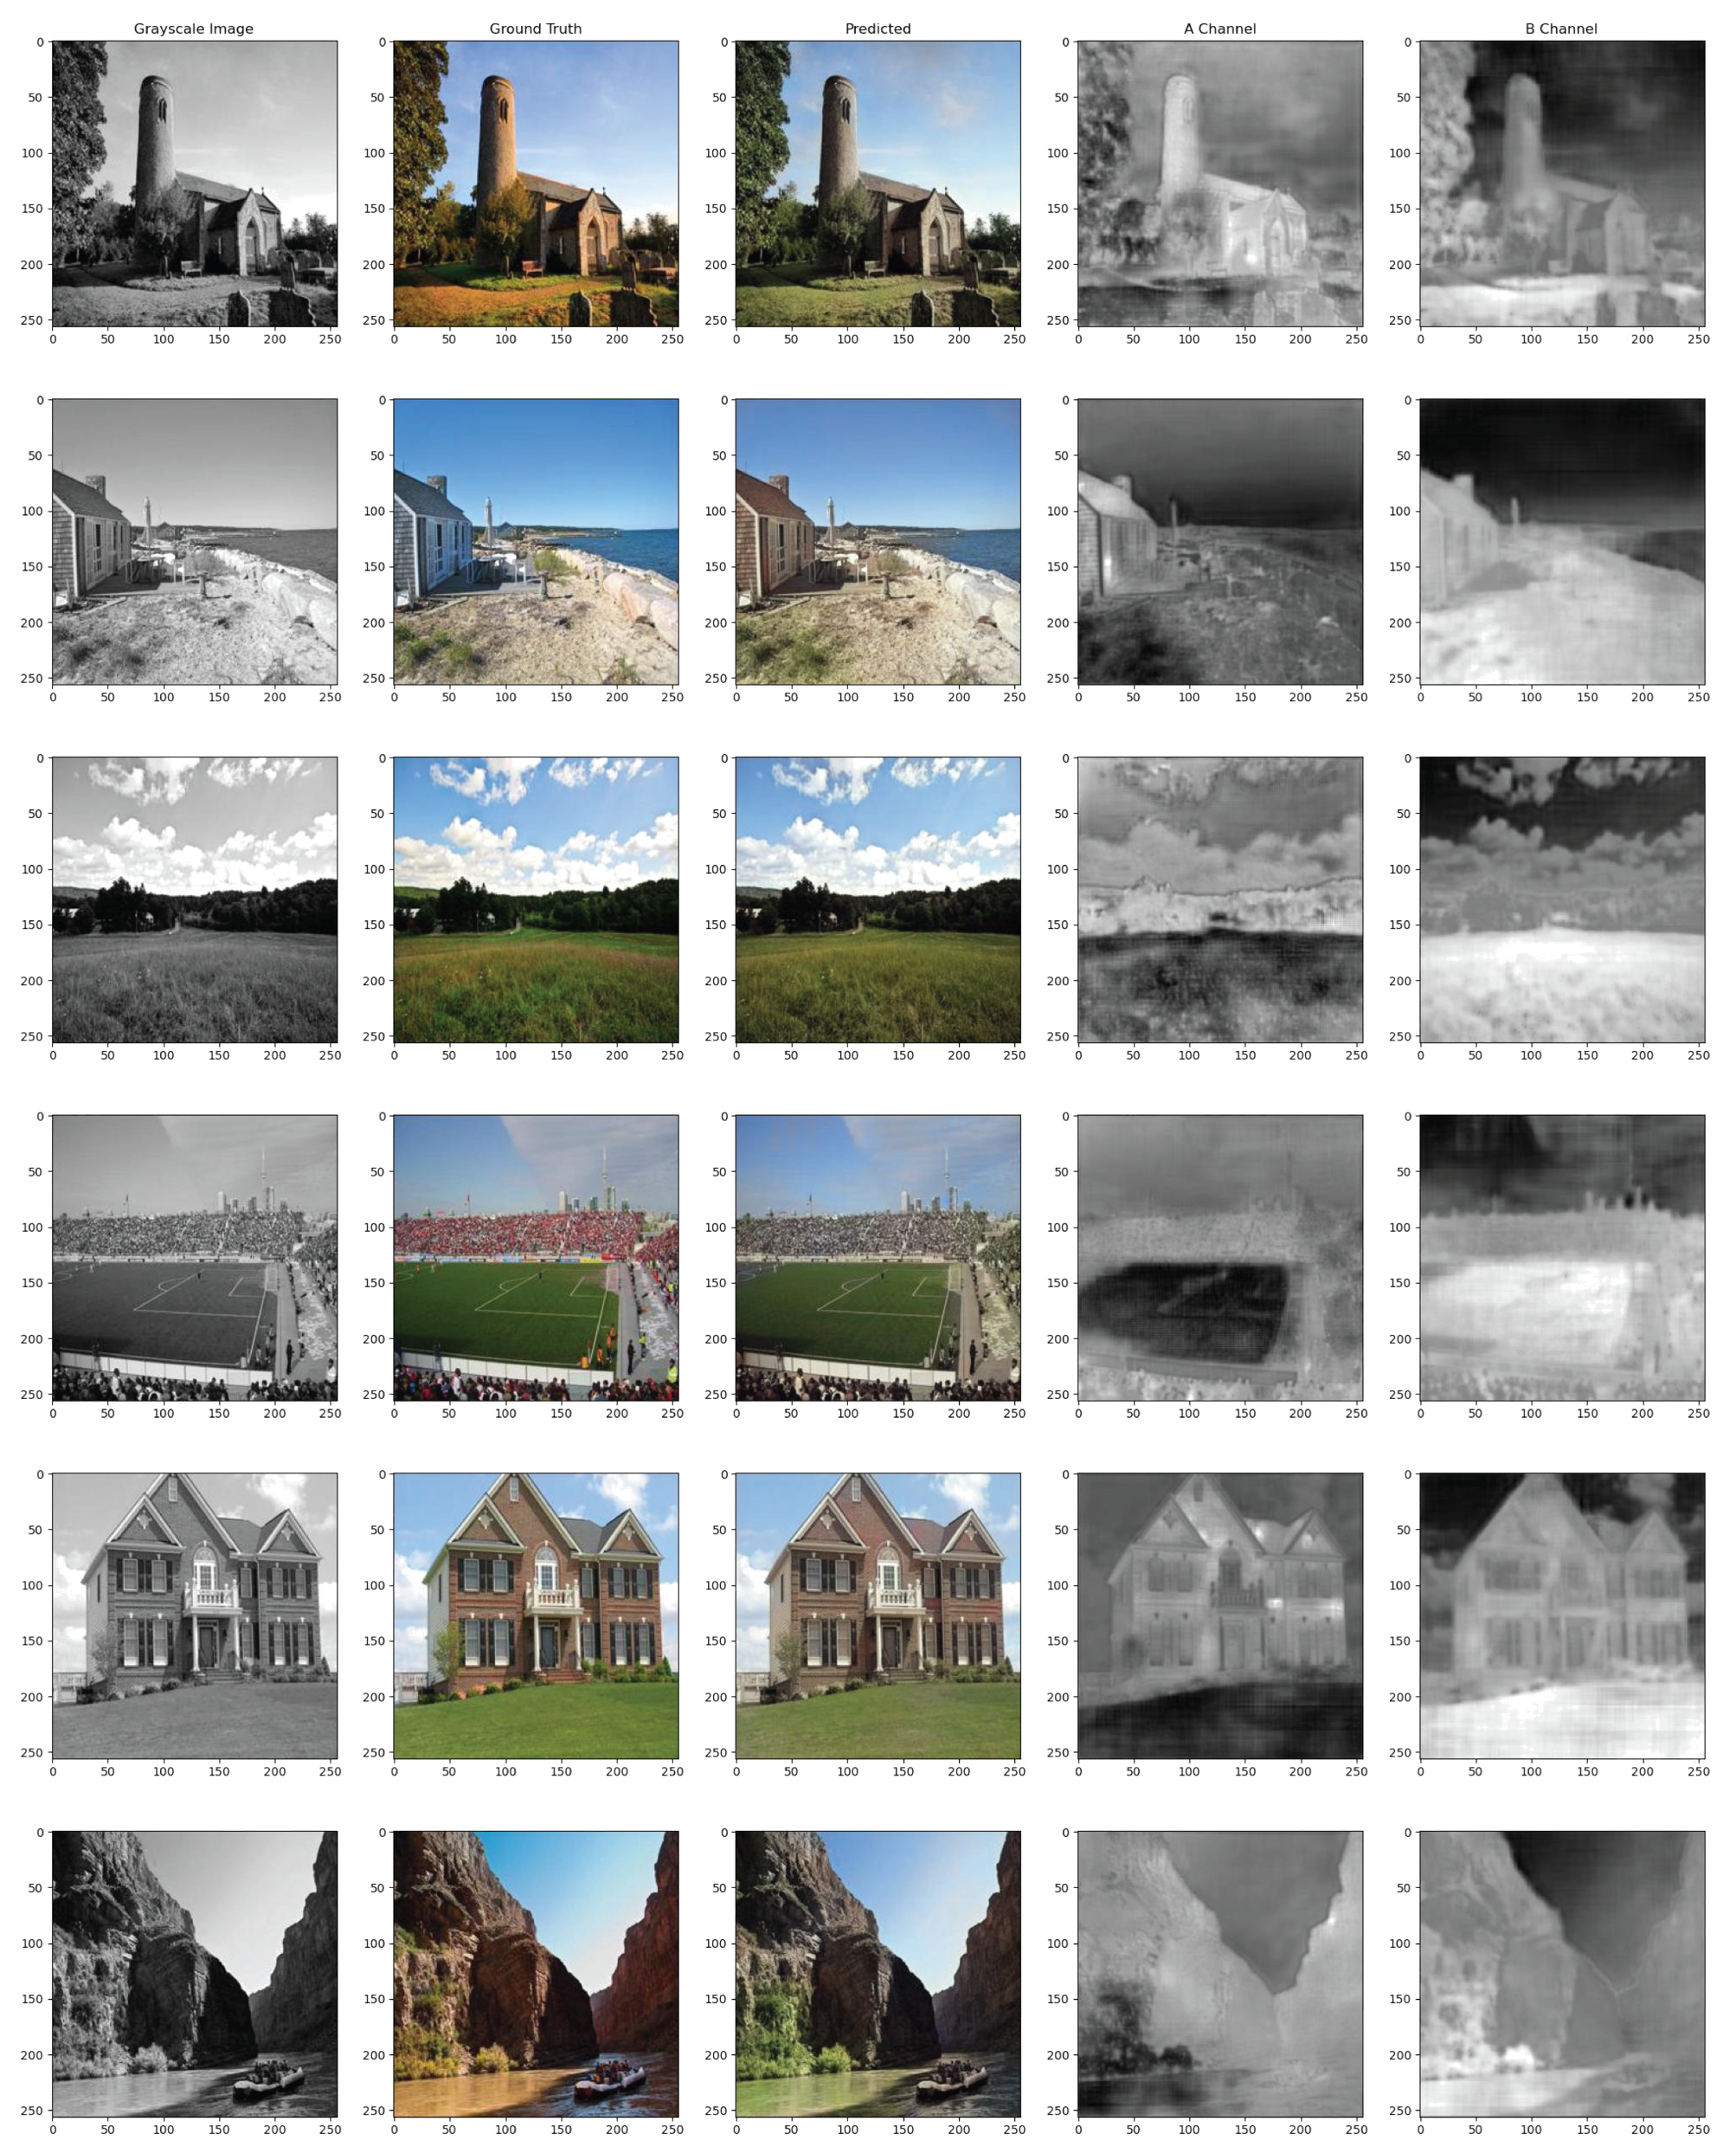
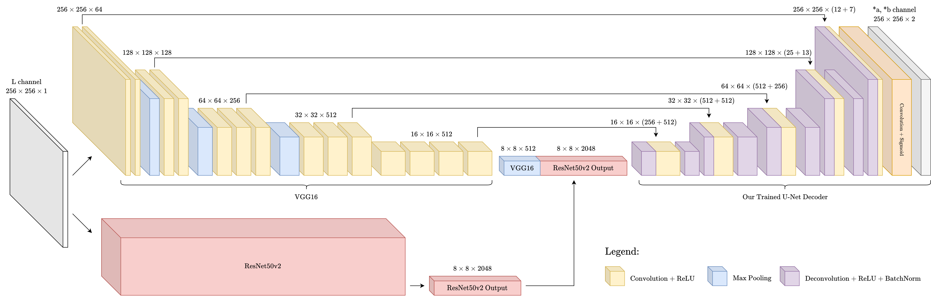
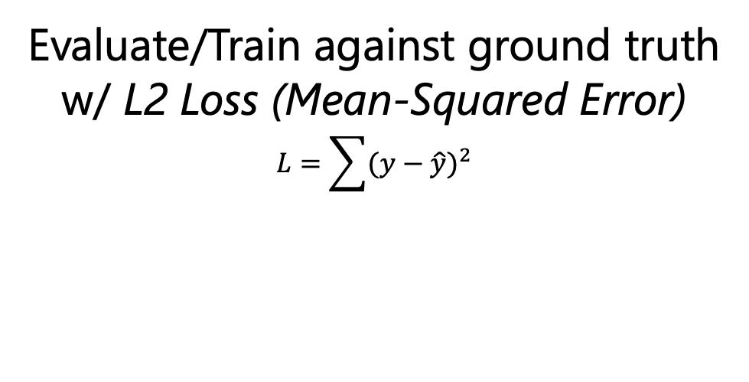
Restoring B+W Photos: Image Colorization with Hybrid U-Net
Jiahua Chen, Kathy Li, Sreshtaa Rajesh, Kiara Vong
Motivation
Datasets
Training Optimizations
Image recolorization benefits:
Restoring old art and/or historic artifacts
Highlighting different features in images (think medical imaging)
Applications in photo editing, data augmentation
Finally… it’s cool!
Before
Due to the fact that we used a number of pre-trained networks in our model architecture, parts of our CNN were trained on the following datasets:
Progressive Resizing
We train our network on progressively larger image sizes. [2]
Training:
VGG: Pretrained on ImageNet
ResNet: Pretrained on ImageNet
Custom head: MIT Places2 test dataset* [1]
Testing:
MIT Places2 validation dataset* [1]
32 x 32
256 x 256
After
Future Improvements
Improve loss function by incentivizing confident guesses for rare colors [3] to decrease ‘averaging’ (sepia colors).
Incorporate a GAN into our model to improve accuracy.
* Note: we used the test dataset for our training because the training dataset was too large to feasibly run on our resources
Results: Good and Bad
How it works
Good:
Landscapes, Homes, Sky, Greenery
Bad:
Patterns, Objects, Warm/Cool Colors, Artifacts
L
Grayscale
Our Model
Predicted *a
Red-Green
*a
Red-Green
Original Image
(RGB)
Evaluate/Train against ground truth
w/ L2 Loss (Mean-Squared Error)
$$L=\sum{{(y−\hat{y})}^{2}}$$
Predicted *b
Yellow-Blue
Colorized Image
(RGB)
*b
Yellow-Blue
(Unintended Side-Effect: our model produces outputs with more color detail than compressed original image!)
Model Architecture: U-Net with VGG16 & ResNet50v2 Backbone
Pretrained VGG16 [4] and ResNet50v2 [5] encoders for rich (high-dimensional) feature tensor.
Trained U-Net decoder: deconvolution + concatenation from appropriately-sized VGG16 convolution tensors.
References
Acknowledgements
[1] Bolei Zhou, Agata Lapedriza, Aditya Khosla, Aude Oliva, and Antonio Torralba. Places: A 10 million image database for scene recognition. IEEE Transactions on Pattern Analysis and Machine Intelligence, 2017.
[2] MosaicML, Progressive Image Resizing
[3] Vincent Billaut, Matthieu de Rochemonteix, and Marc Thibault. Colorunet: A convolutional classification approach to colorization. CoRR, abs/1811.03120, 2018.
[4] Karen Simonyan and Andrew Zisserman. Very deep convolutional networks for large-scale image recognition, 2014.
[5] Kaiming He, Xiangyu Zhang, Shaoqing Ren, and Jian Sun. Deep residual learning for image recognition, 2015
We would like to thank the CS1430 course staff (especially Miku) for their wonderful support; James for his wonderful teaching and instruction; CCV/GCP for compute; and a Stanford CS231n final project [3] for inspiration.

